Slide 1
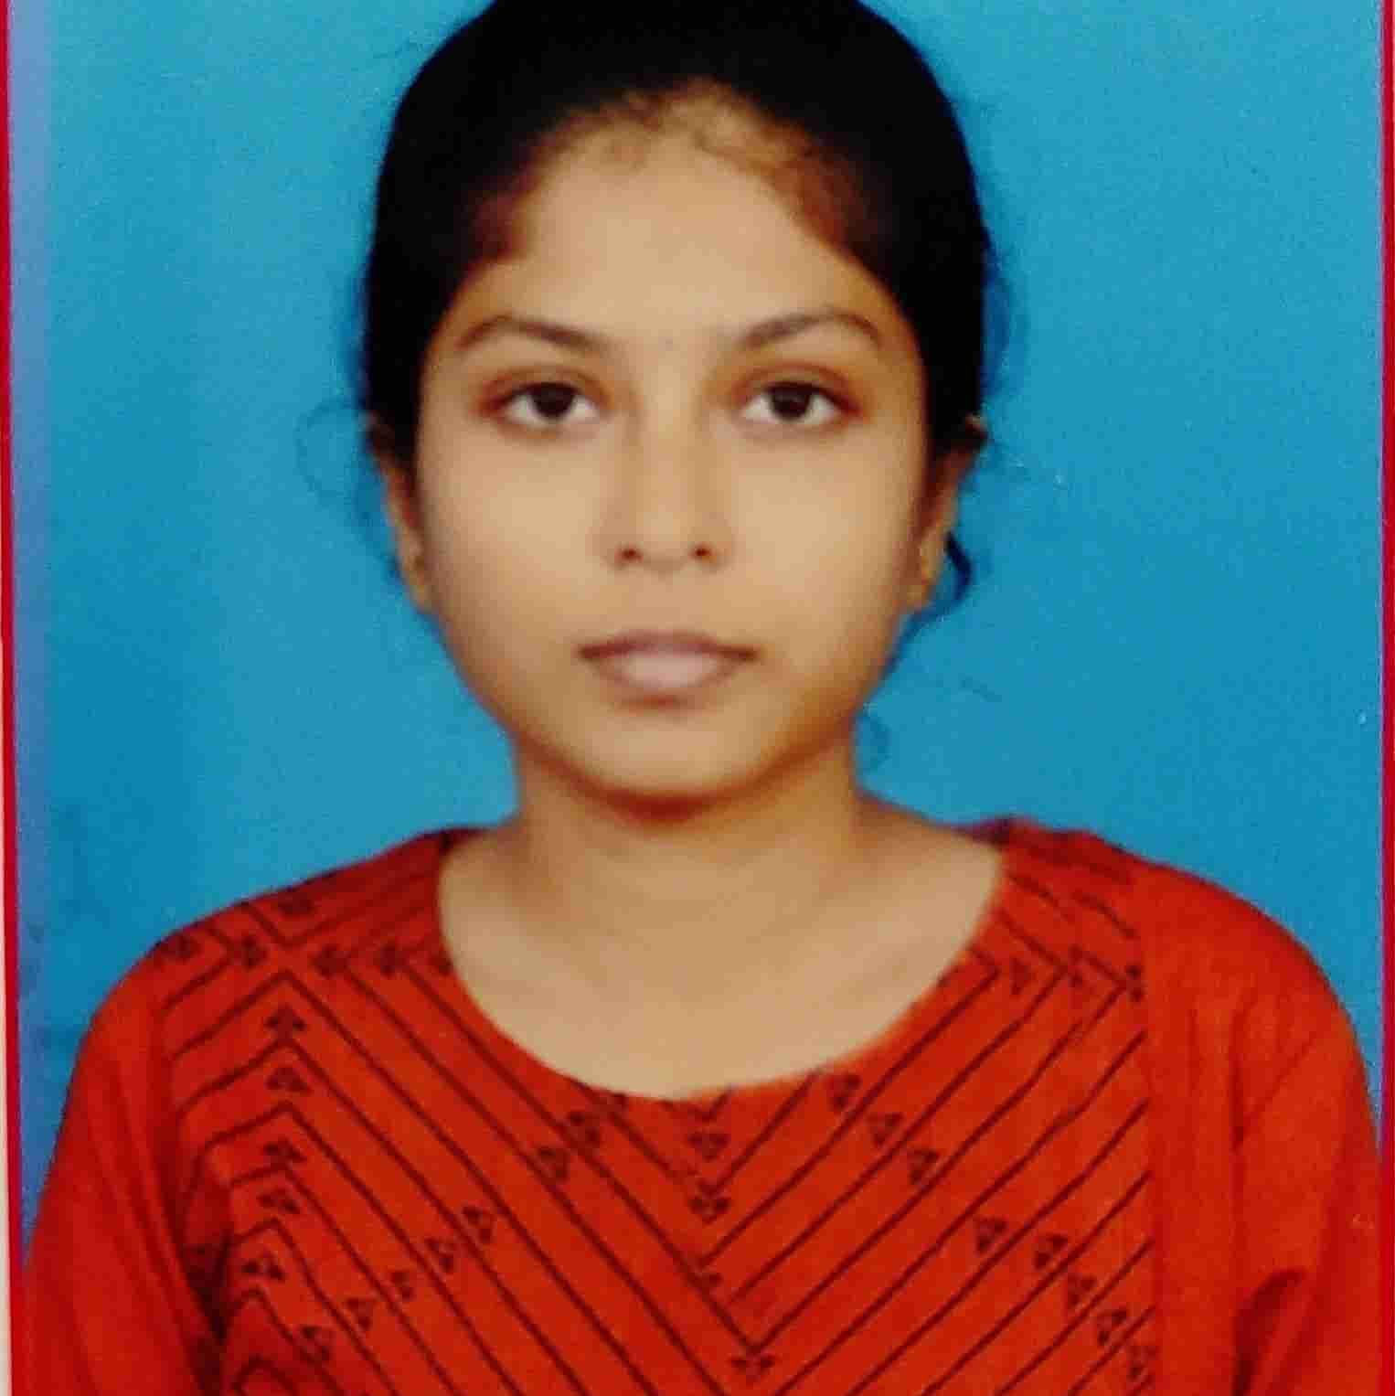


Sai Divya Sree Bellamkonda
Analyst/Software Engineer
Bachelor of Engineering
Electronics and Communication : 2018 -2022
Skills
Bangalore
Java 8 | Java Basics, OOPS, Collections, Arrays, Loops, Lambda Exp, Stream API Junit, Mockito
Spring core | IOC & Dependency Injection, Autowire
Spring REST | REST controllers, Implementation of GET, POST, PUT & DELETE, Exception Handling, Testing services.
Spring Boot Microservices | Spring Boot Starters, annotations, Swagger API documents
Spring Cloud | Eureka server, Netflix Eureka Client, resilience4j, Spring cloud API gateway
Angular | Components, Services, Modules, Routing, Forms & Validation, Testing using Jasmine & Karma
Database | MongoDB Atlas
UI Tech | HTML 5 & CSS 3, ES6 & TypeScript
Tools | Postman, IDE
Add On skills | Team management. Peer learning,Communication
sai-divya-sree.bellamkonda@capgemini.com
+91 6303209767
A4
EMP ID: 46290512
Hands-on experience in creating microservices with Spring Boot, Spring Security, Spring Cloud API Gateway, Eureka server, Resilience 4J, Load balancing including Logging using SLF4j.
Experience in creating documentation with Swagger and in unit testing using Junit, Mockito.
Hands-on Experience in creating Single page Web Application in Angular with Authentication, route guards, Angular reactive forms, angular routing, gateway port for end points including testing using Jasmine and Karma.
Currently preparing for AWS CCP
On Demand Car Wash Application
Completed case study of On Demand Car Wash Application along with JWT authentication, Swagger and payment gateway using Razorpay, spring cloud API gateway, unit testing using Junit , Mockito and Angular used for user interface.
Book App
Done small practice project on Book App with angular as user interface, spring boot and SQL for backened.
Check out my work on GitHub & Video Profile

